Slide 1

CASE STUDY
Group Name:
Karandeep Malik
Avinash Kumar
Anuradha Cherukupalli
Vaibhavi Shendge

Slide 2
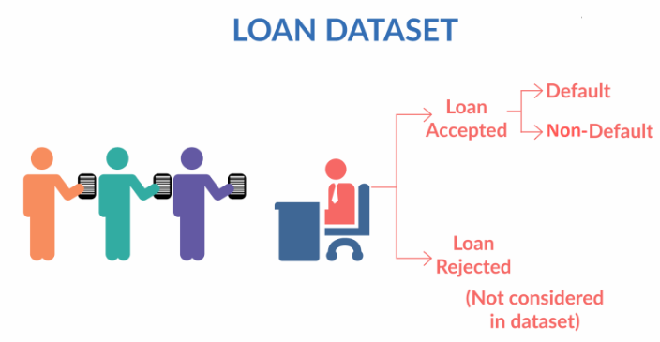
Problem Statement:
To identify the driving factors behind the loan default and also identify the patterns which indicate if a person is likely to default, which may be used for taking actions such as denying the loan, reducing the amount of loan, lending(to risky applicants) at a higher interest rate, etc.

Slide 3


Problem Analysis
Basic Understanding:
The given data set contains the complete loan data for all loans issued through the time period 2007 to 2011. The data has three categories of loan status via. Charged off, Fully Paid and Current. As we have to find the driving factors behind the default, we will focus on Charged off applicants.
Methodology: Tools Used
Data cleaning
EDA
Plotting the results

Slide 4
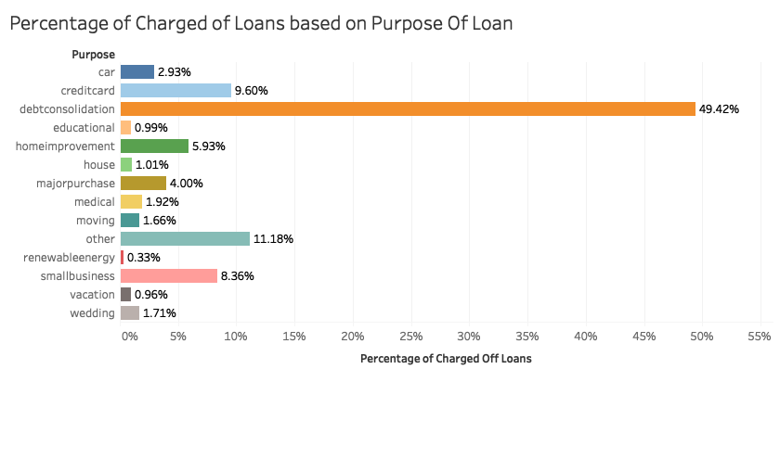
Plot 1: The plot below shows that purpose of loan with the percentage of Charged off loan. The applicants having debt consolidation purpose of loan are among the most defaulters, followed by thos taking loan for purpose:- other, credit card and small business
Plot1

Slide 5
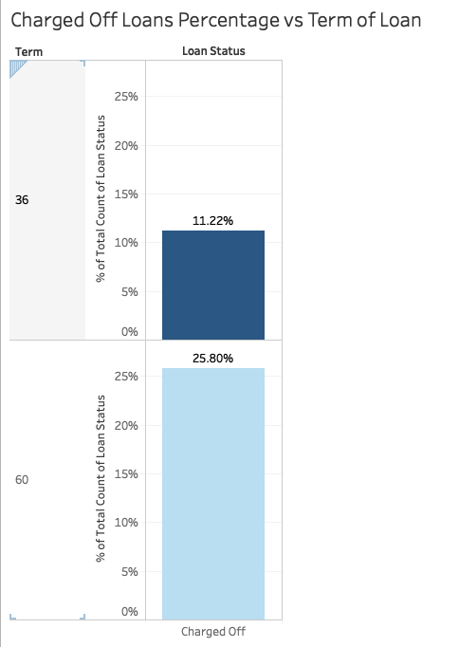
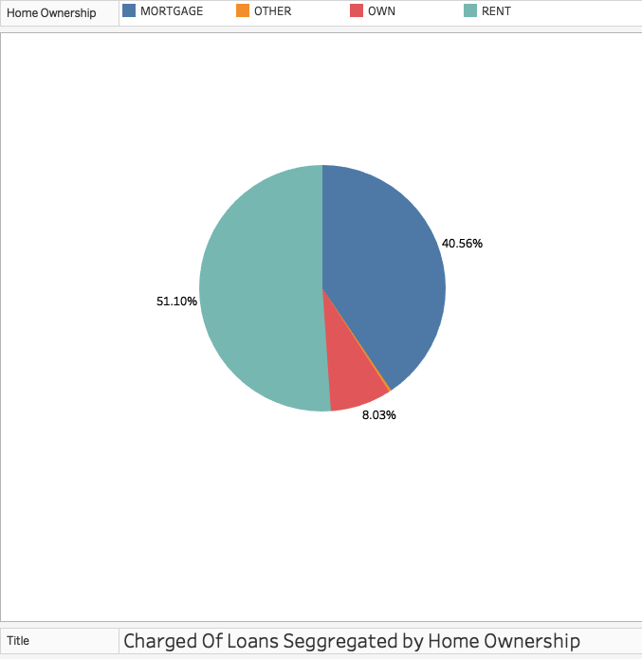
Plot1: It shows the Charged off loans percentage with the duration of loan i.e. 36 and 60 months. It is observed that Charged Off Loans were higher for 60 months duration as compared to 36 months duration Plot2: It shows the segregation of Charged off loans with the Home Ownership. People who have rented homes or have house mortgaged were higher among the defaulters
Plot1
Plot2

Slide 6
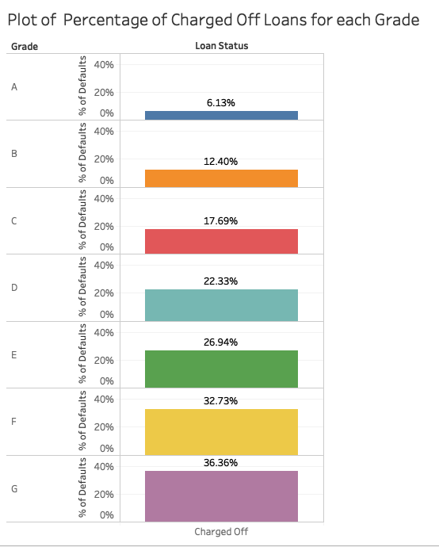
Plot 1:- It shoes the Dharged of Loans per Grade Gateory assigned by Lending Club. From the below plot we can say that the grade G has the highest percentage of Charged off loans and Grade A has the lowest percentage.
Plot1

Slide 7
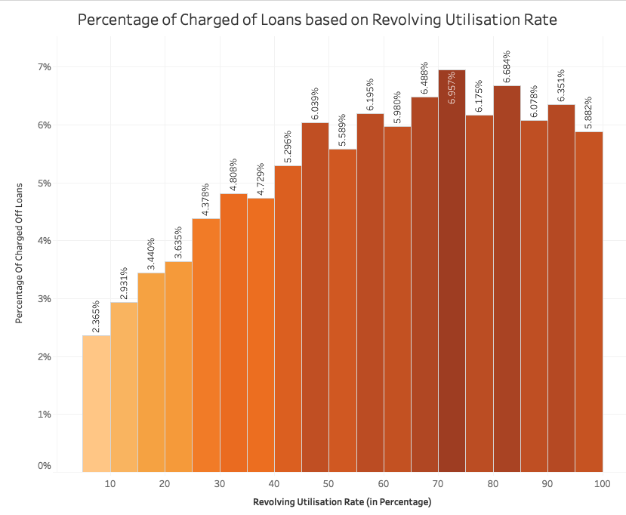
Plot1: It shows the Revolving Utilisation Rate vs Percentage Of charged Off Loans. It appears that as the Revolving Utilisation Rate increases the chance of defaulting loan increases.
Plot1

Slide 8
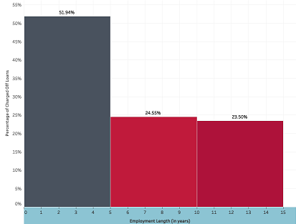
Plot 1: We have split the Employment Length column in three stages
0 to less than 5
5 to less than 10
10 to 10+
So from this we can say that the applicants having employment length in between 0 to 5 years has the maximum chances to get Charged off
Plot1

Slide 9
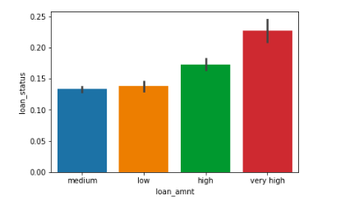
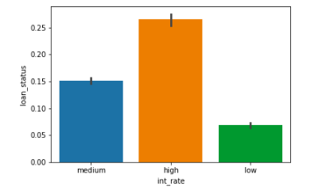
Plot1 shows the analysis of Charged Of Loans for each Loan Amount . It can be seen that as the Loan Amount increases the change of loan getting charged off loans increases Plot 2 shows the analysis of Charged Off Loan for different interest rates. As the Loan Interest rate increases. The probability of loan getting charged of increases.
Plot1
Plot2

Slide 10
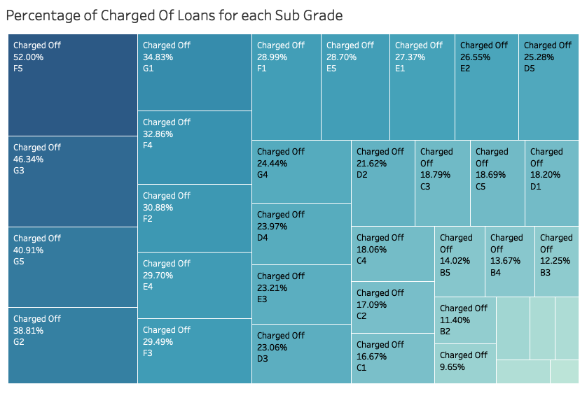
Plot1 shows the analysis of Charged Of Loans for each Sub Grade Assigned by Lending Club. This graph shows that the amount of defaulters are more in sub grades F5 and G3
Plot1

Slide 11
Plot1 shows the analysis of Charged Of Loans vs Debt to Income Ratio. People with Higher Debt to Income Ratio Default more.
Plot1

Slide 12
Plot1 : It shows the analysis of Loans Status vs Public default records of bankruptcies. People who have had previous record of bankruptcies defaulted more
Plot1

Slide 13
Conclusion :
The key drivers of loan defaults as per the given data are:-
Purpose of Loan
Loan Tenure
Home Ownership
Grade Segment
Revolving Utilization Rate
Year of Employment
Loan Amount
Loan Interest Rates
Public record Of Bankruptcies
Debt to Income Ratio
Recommendations :
The Consumer Finance Company while dispersing loans should take into account the following :
Loan amount is lower than 10000$
Purpose of Loan not debt consolidation or credit card loan.
Interest rate is in the range 10-12
Customers should have an income higher than 50000.
Loans should be of a lower term (more 36 months loans than 60 months loans)
The Debt to Income Ratio of customers should be checked to give out more loans to customers with a favourable ratio.
Loan Grades and Sub Grades are a good predictor of default, and should be used more often while giving out loans.
Lower Debt to Income Ratio and Lower Revolving Rate Utilisation

